Slide 1
Voting Turnout
Erin, Camille, Rabia and Sayali
Notes:
Erin
· Our group project focuses on voter turnout in Detroit and the obstacles voters face regarding transportation accessibility

Slide 2
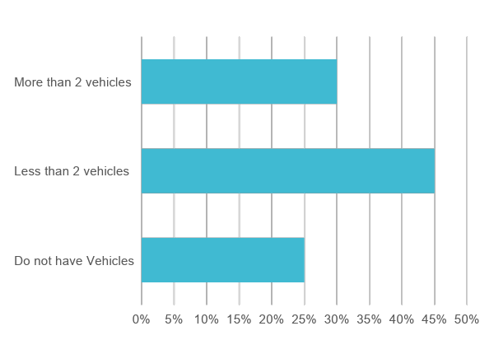
Business Problem
Less voter turnout of Michigan compared to other states in 2016
Less voter turnout of Detroit in 2016 compared to 2012
Increase accessibility by reducing transportation challenges
Focus on Detroit voters as stakeholders
Gaps in voter turnout historically affect marginalized groups of people
Limited accessibility to personal transportation
DDOT serves 12-13% of population with approximately 85,000 riders each day
Notes:
Erin
· Voter turnout in 2016 was lower in Detroit than other areas in Michigan
· Comparing 2012 to 2016, voter turnout in Detroit decreased by about 65,000 and even though the turnout increased in other places in Michigan – Detroit specifically experienced an opposite effect. We also see that this is a trend, as Detroit turnout was lower than the state average for the primary election in March of this year.
· The business problem we aim to solve is to increase accessibility by reducing transportation challenges.
· Stakeholders include Detroit voters, political candidates, public officials, and the general public. Since this issue spans a vast group of stakeholders, we will focus on the perspective of Detroit voters.
· Based on census data, Detroit residents have limited access to personal transportation.
· About 25% of Detroit households do not have a vehicle, and 70% have fewer than 2 vehicles.
· Given that at least 60% of households include more than one person, that means in the best case 10% of households in Detroit rely on other forms of transportation.
· The Detroit Department of Transportation or DDOT, serves about 85,000 riders a day and given census data, we conclude that DDOT serves 12-13% of the Detroit population.
· Solving this business problem is important since gaps in voter turnout have historically affected marginalized groups of people. Increasing turnout in Detroit will lead to more representative results in local elections.

Slide 3
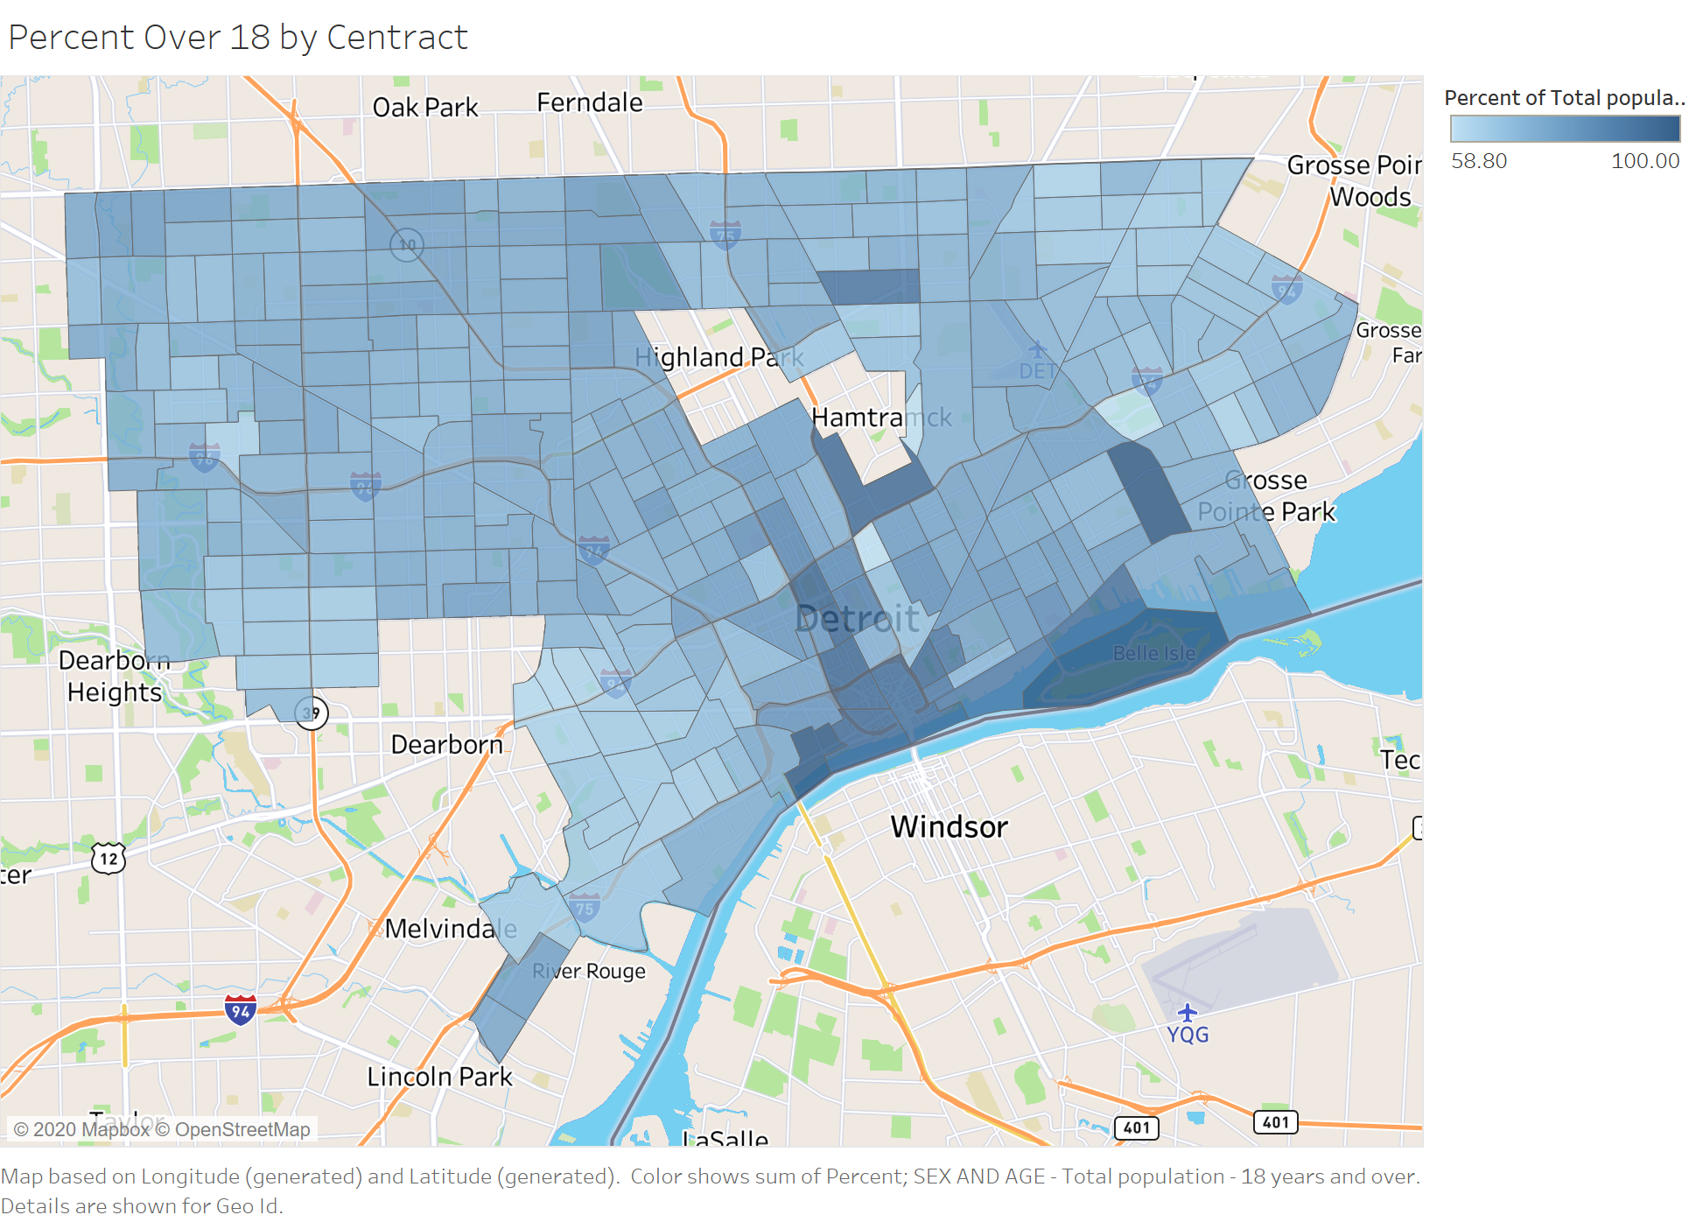
Analytical Problem
Minimize voter’s travel time to polling location
Reduce the distance from accessible transportation to polling locations
Reduce time spent waiting for transportation
Current polling location spread and accessibility by using public transportation
Public transportation routes connecting people to polling locations and frequency of buses
Population density for age above 18 for each area in Detroit
Notes:
Erin
· The analytical problem we are trying to solve is to minimize a voter’s travel time to get to the polling location
· We intend to reduce the distance from accessible transportation to polling locations and reduce time spent waiting for transportation.

Slide 4
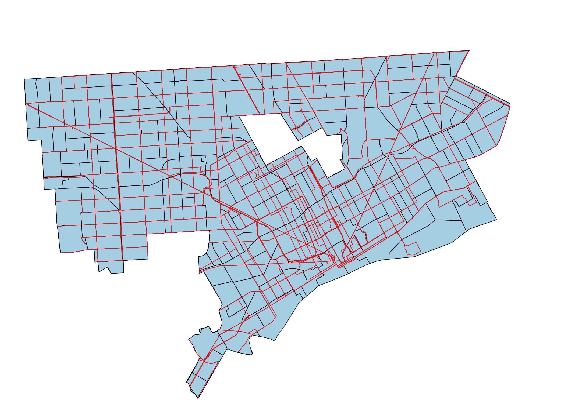
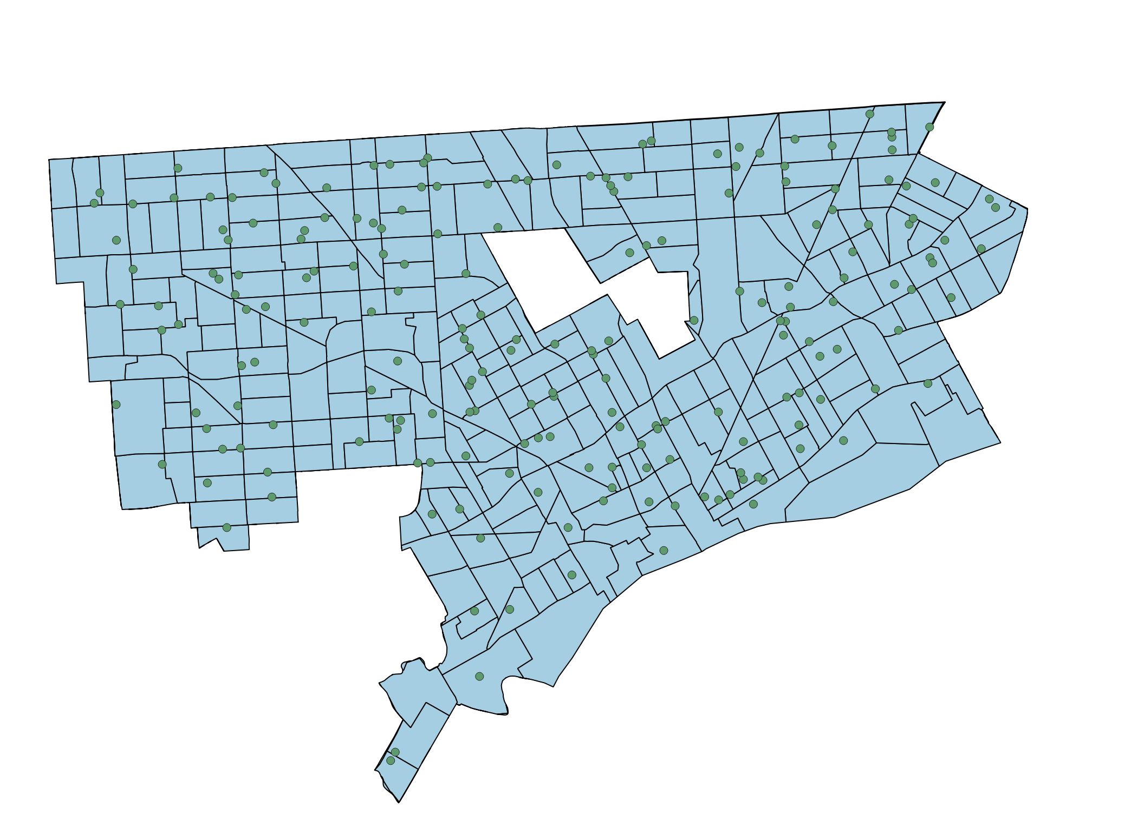
Data
Polling Locations
Bus stop locations (DDOT & SMART)
Bus Routes (DDOT & SMART)
Bus frequencies on each route (DDOT)
Centract for Detroit
Population per Centract
Notes:
Erin -
· For data, we used a variety of publicly available datasets including data from the City of Detroit and census population data from 2010. The Detroit data is divided into precincts, but census population data did not include voting precincts, so we used the census tracts to break out data into smaller sections.
· This allowed for a more in-depth analysis which helps identify areas of greatest need when considering income and population density. This in-depth analysis will be useful when prioritizing steps in implementation.
· Data was unavailable for bus and driver supply as well as addresses for eligible voters. We also had limited data on DDOT’s budget, so we will be making the following assumptions –
o The DDOT budget is limited and the greatest needs should be addressed first
o The number of buses and bus drivers is limited, and DDOT will not be able to add election day buses to all the existing routes.
o SMART bus routes and stops are not relevant to this analysis because these routes serve the suburban population. Since polling locations are tied to residence, these long-distance routes are not useful to our study.
o And finally, we are also assuming that political candidates, public officials, and the general public are interested in improving voter turnout in Detroit.

Slide 5
Approach
Use of QGIS and Tableau for Analysis
Plot and clip the City of Detroit per Centract
Analyze the reach of each Centract to Polling Location
Identify the problematic polling locations from all polling locations
Find the improvement opportunities
Notes:
Sayali

Slide 6
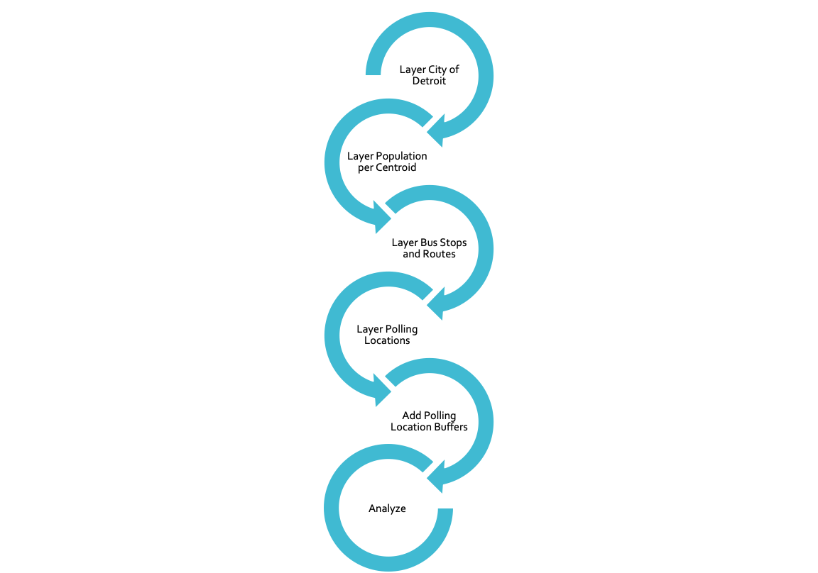
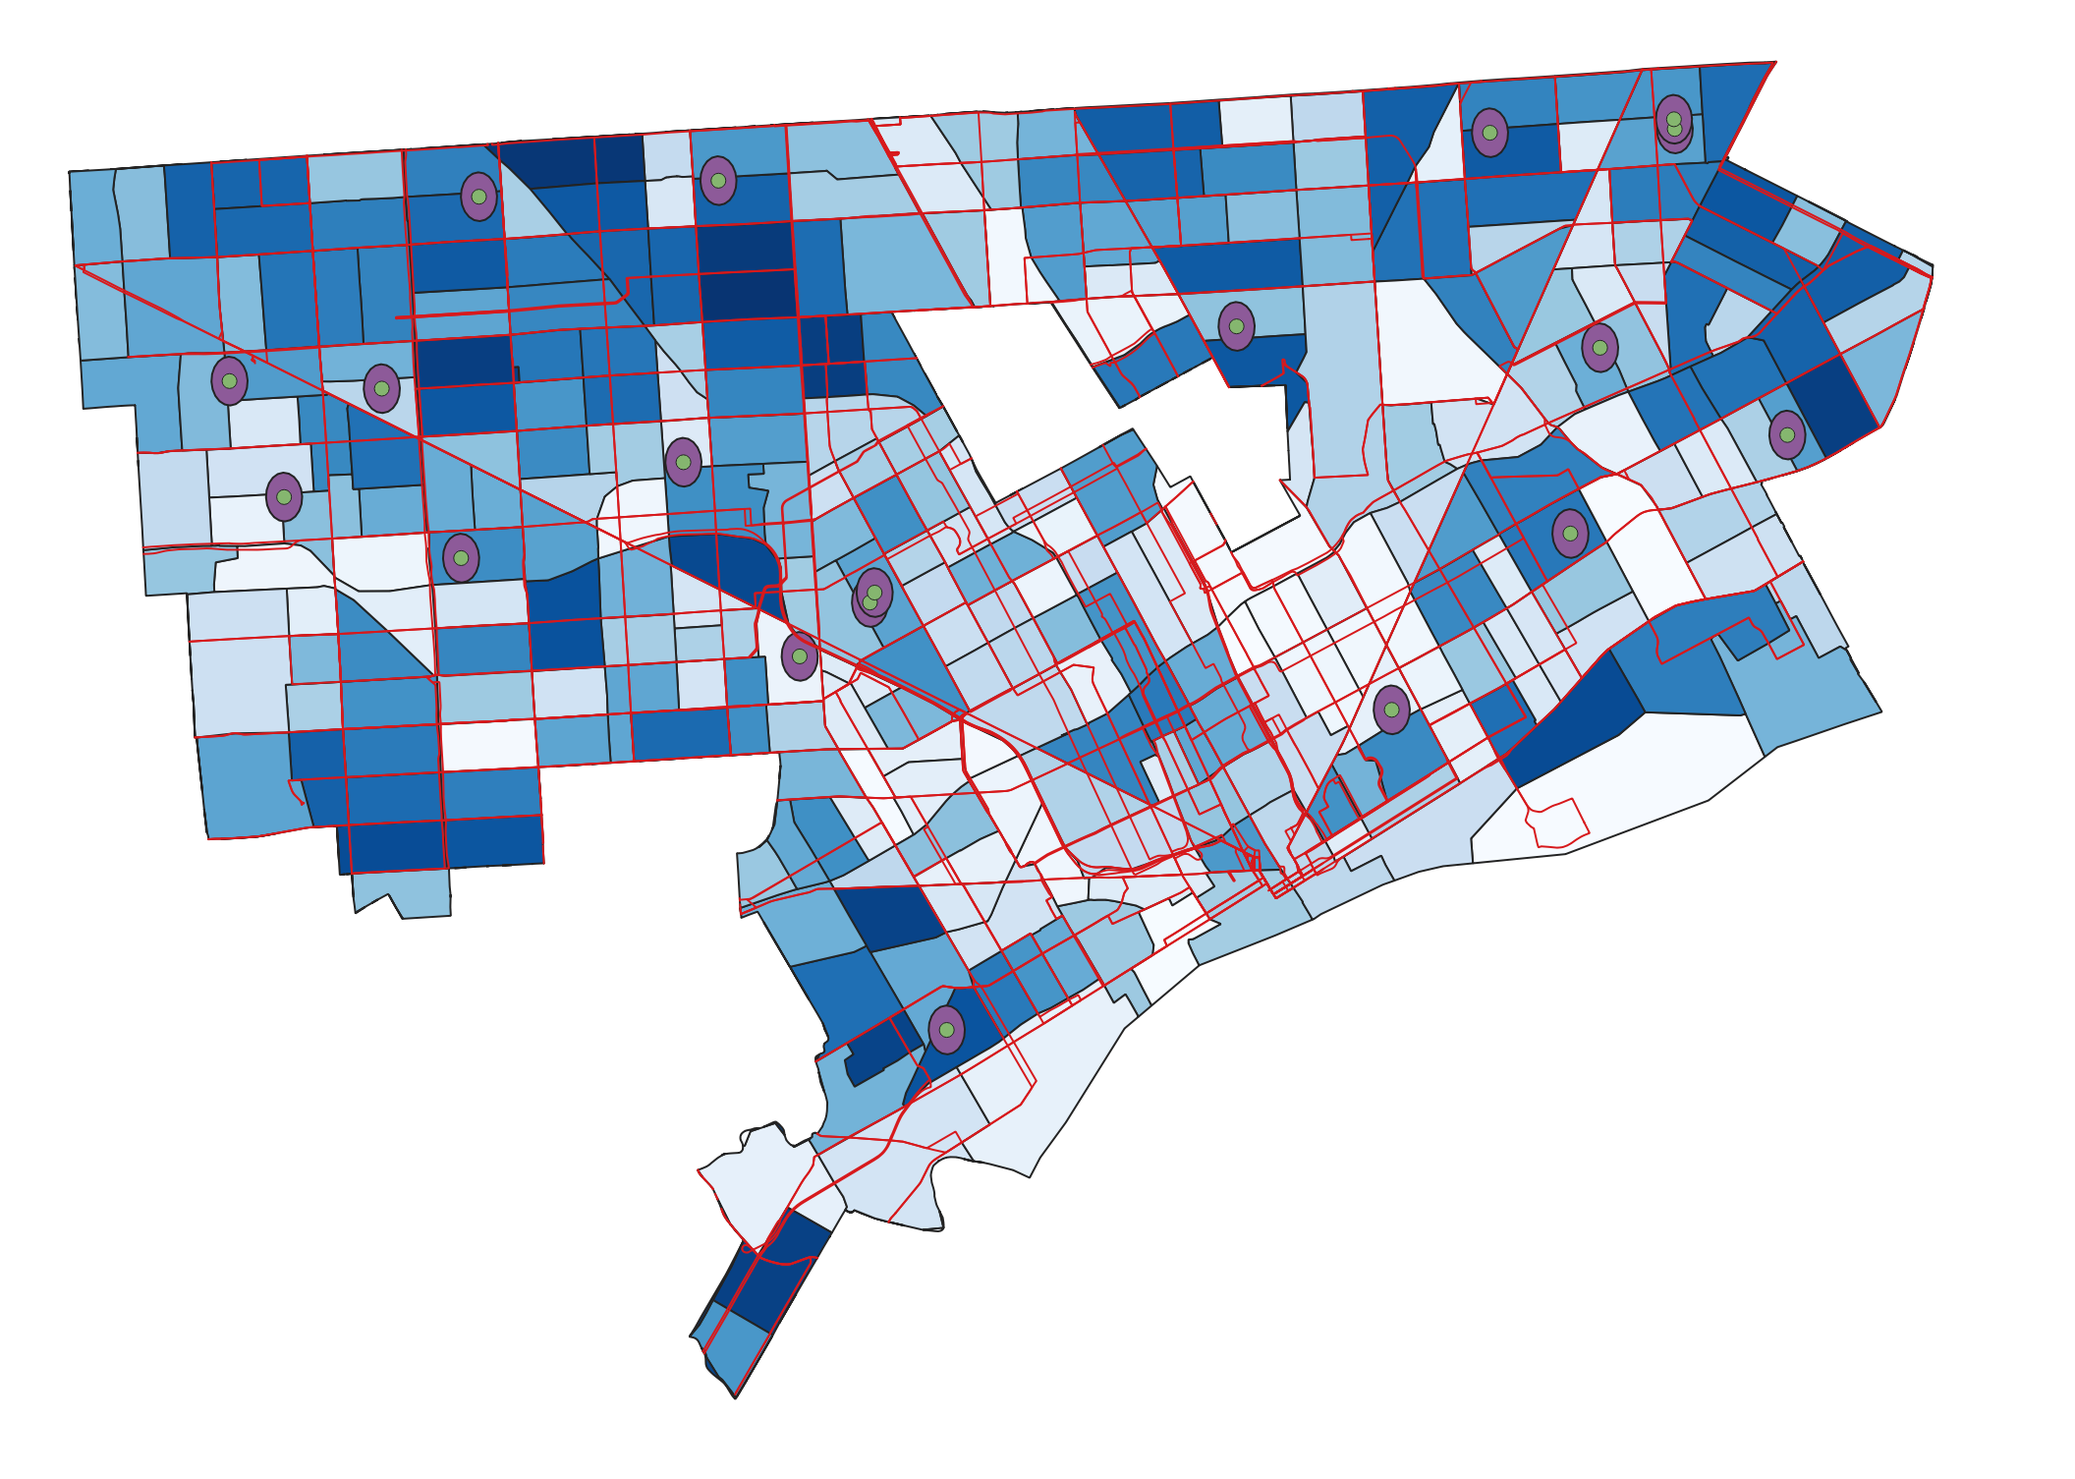
Model Building
Notes:
Sayali

Slide 7
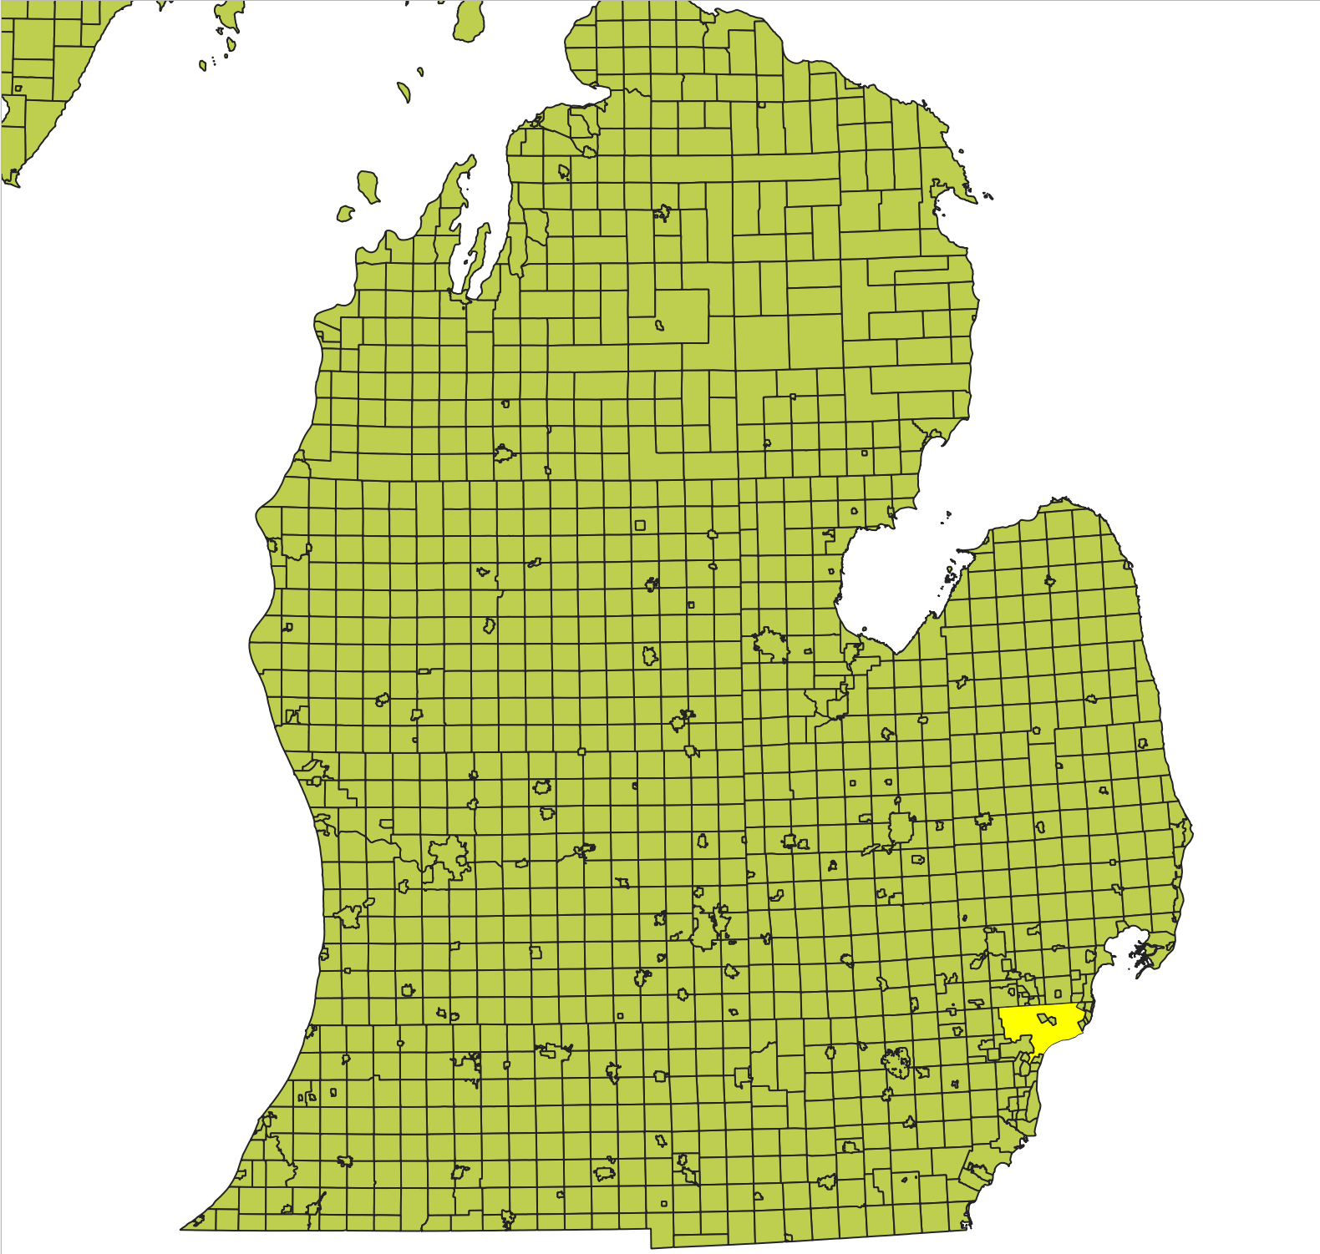
Clip the Detroit city data from entire Michigan Data
Notes:
Sayali

Slide 8
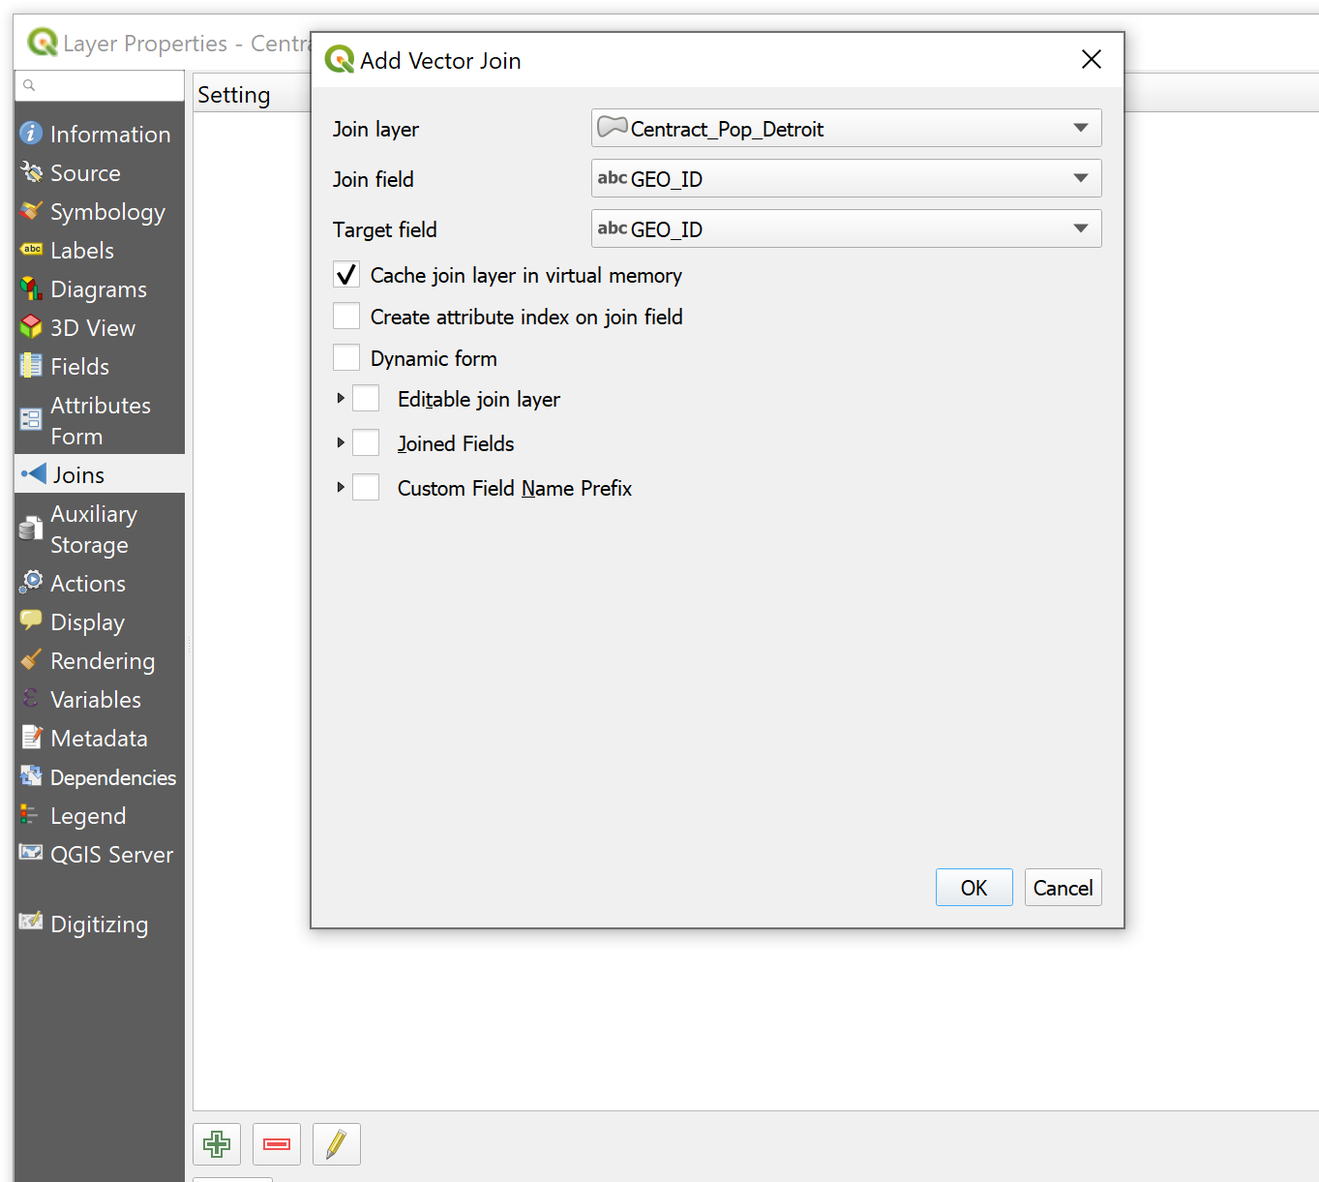
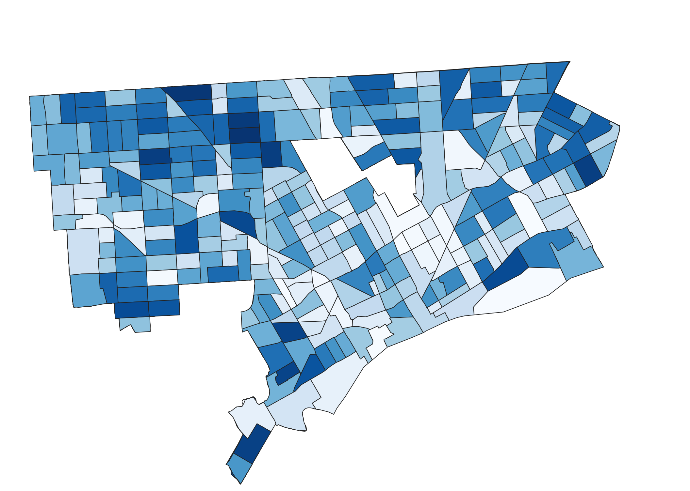
Merge Centract and population data from two different files
Notes:
Sayali - joining population attribute table with centract table by GEOID

Slide 9

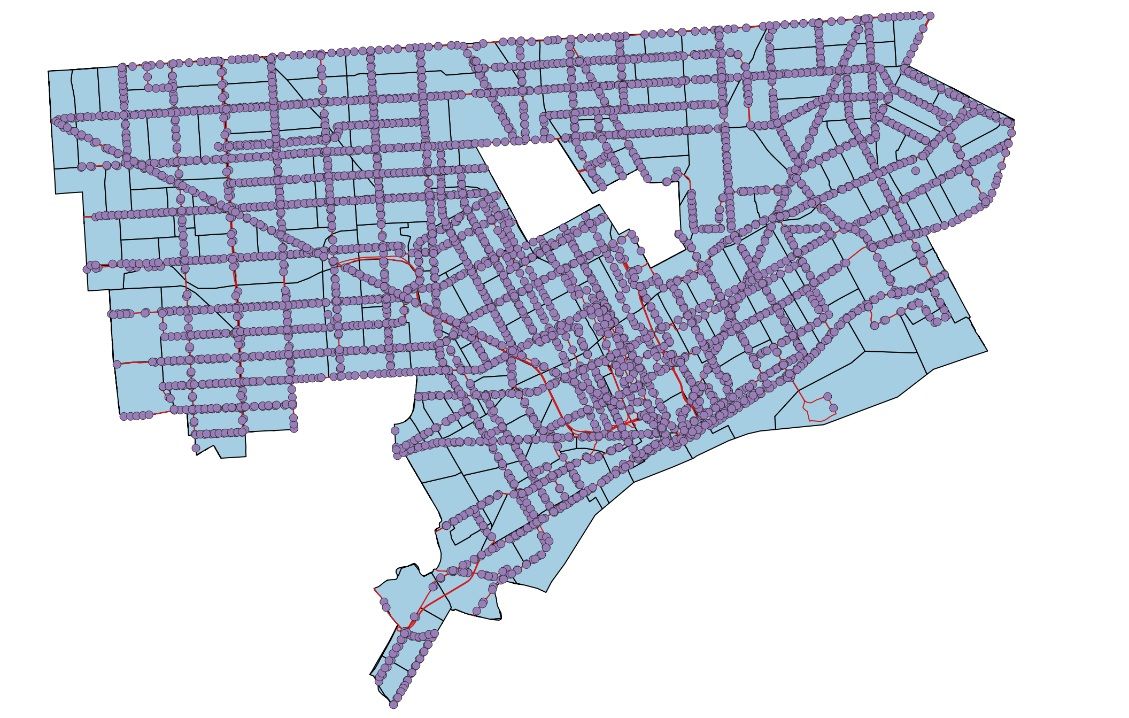
Bus Routes
Bus Stops
Notes:
Sayali

Slide 10

Notes:
Sayali

Slide 11
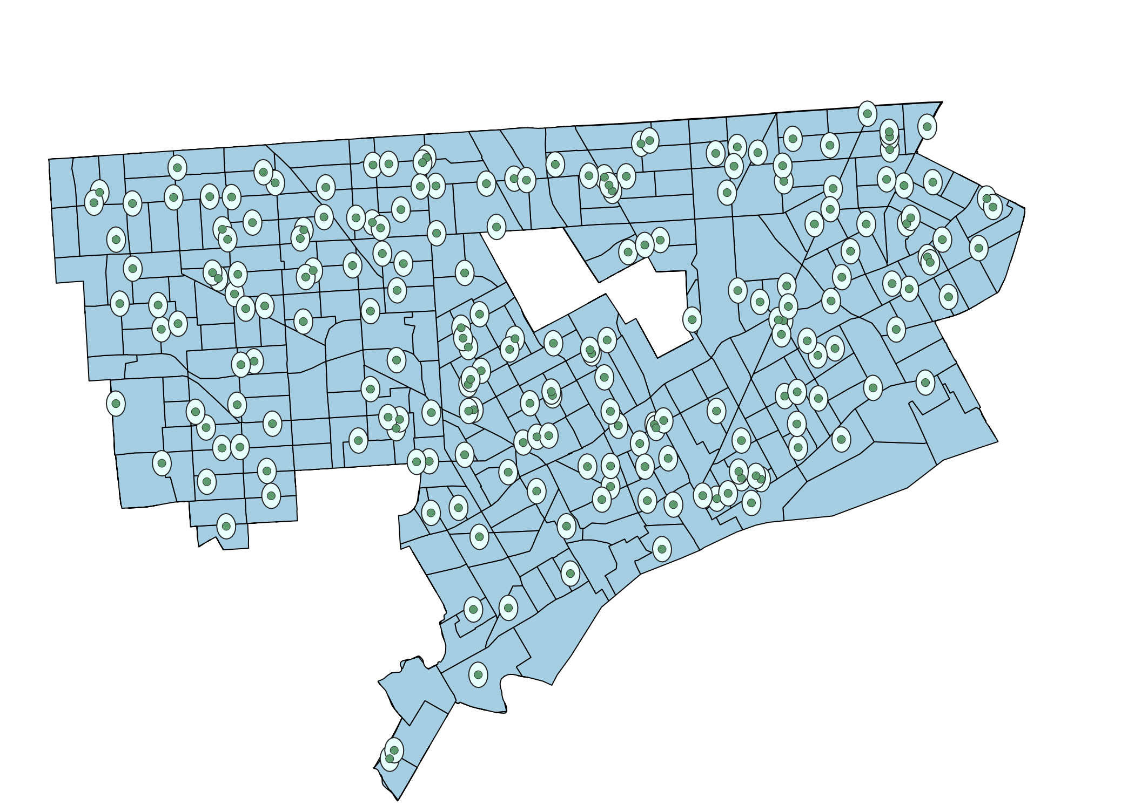
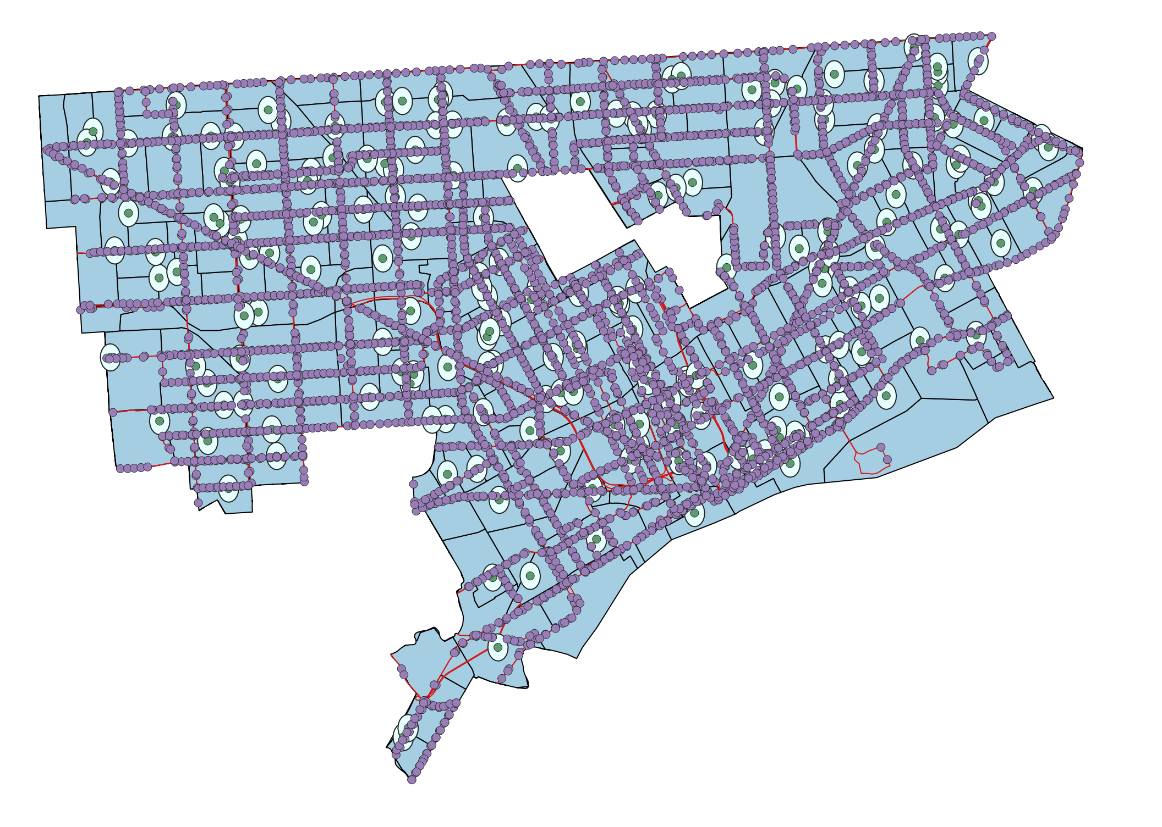
Buffer of 0.25 mile around each Polling location
Buffer interaction with bus stops
Notes:
Sayali - geoprocessing tools>buffer
.25 mi is roughly 0.0036 degrees

Slide 12
Analysis
Where we need more frequent buses
Bus route frequencies
Identifying routes that need more frequent buses
Where we need more stops
Identify polling locations that need better bus access
Measuring distances from polling locations to buses
Prioritizing polling locations by population
Notes:
Rabia

Slide 13
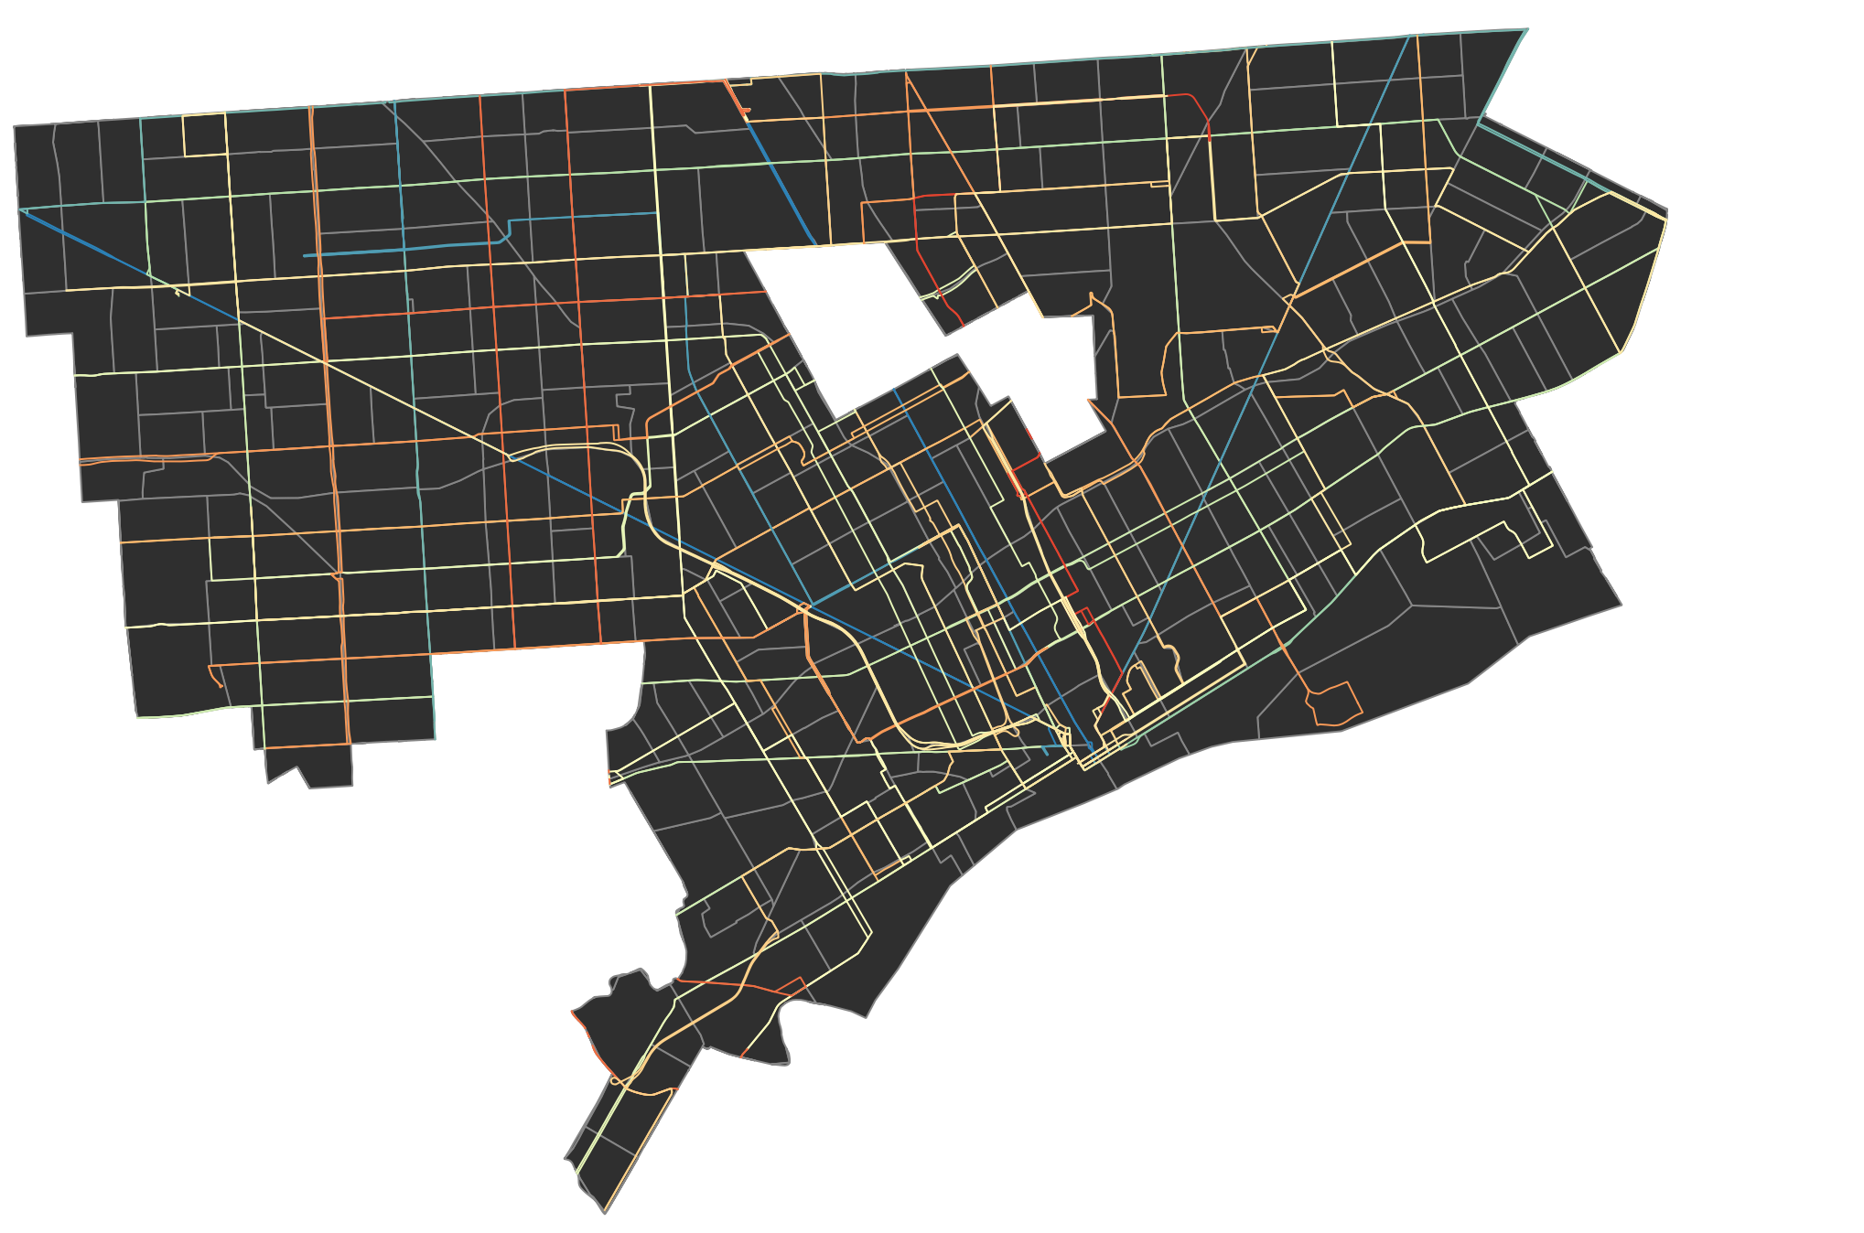
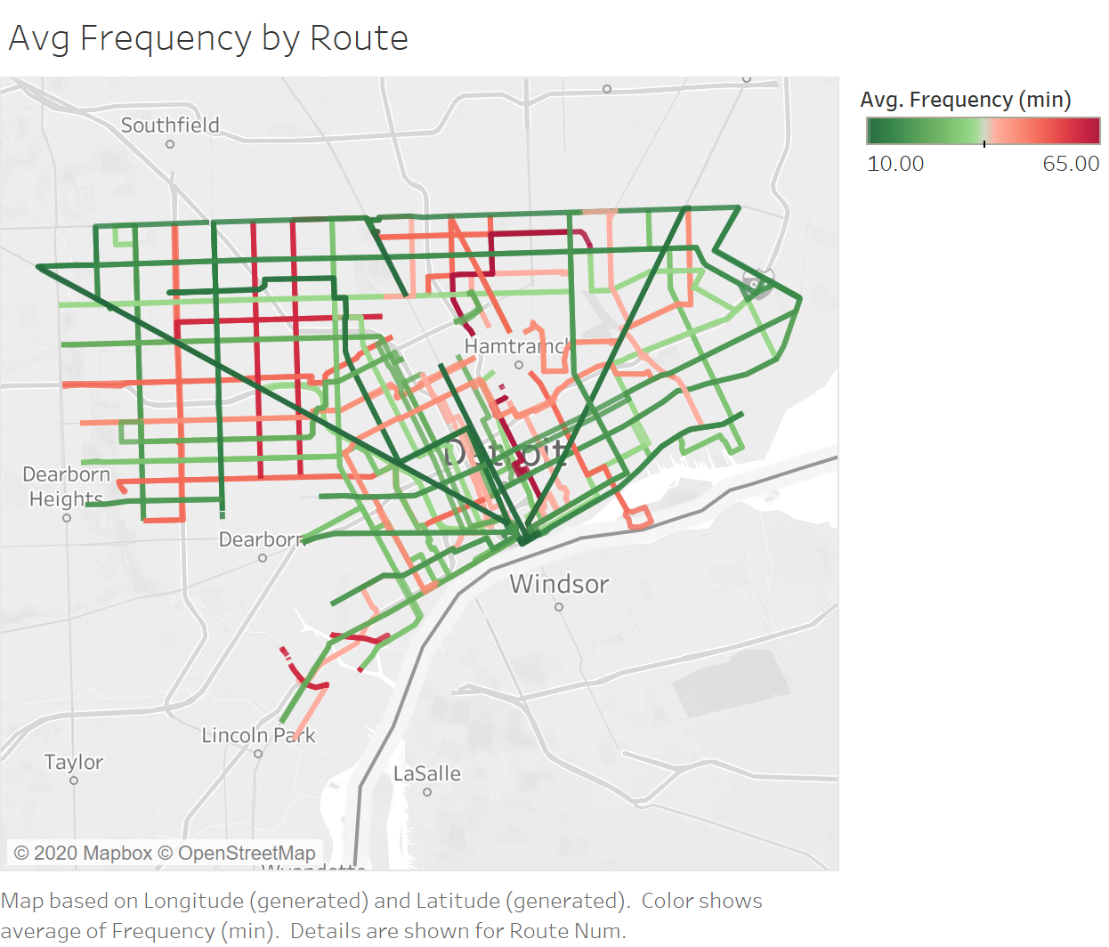
Bus Route Frequency
Notes:
Rabia
join freq data with routes, colorize by categorizing in gradient in QGIS or setting color in Tableau
DDOT schedules using their best (fastest) times throughout the day, as that capacity/ability is established

Slide 14
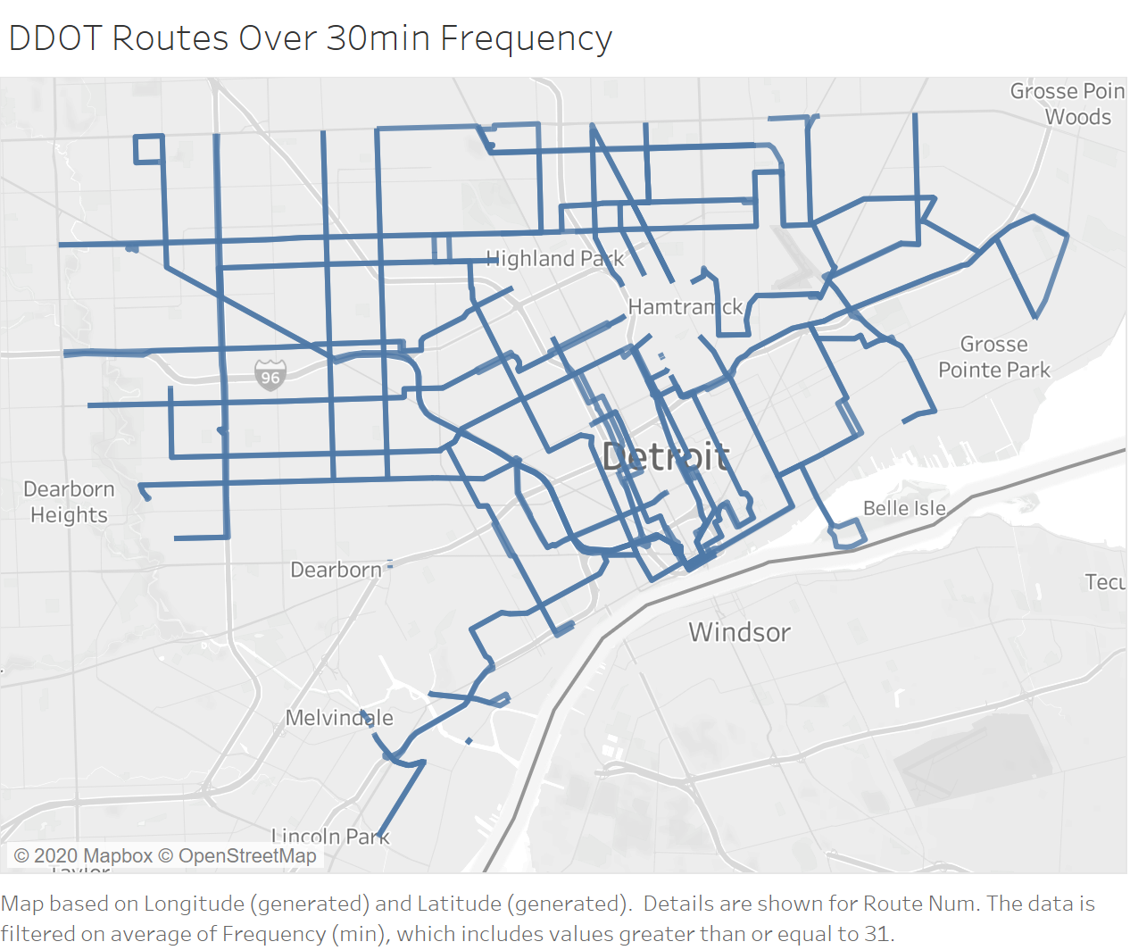
Bus Route Frequency Over 30 min
Notes:
Rabia
20 routes out of 43
We studied the frequency of bus stops during a weekday, along the different routes (Bus Schedules). From this list, we sorted the routes to find which routes have the longest wait from one bus to the next. We set a limit for waiting time: we consider all routes with wait times greater than 30 minutes to be unacceptable and in need of attention. Based on this analysis, we have identified 20 routes to be considered for improvement on Election Day (Appendix C). Additionally, we used QGIS to visualize the routes that are the most troubling so give a greater view of what areas require the most attention (Appendix D).

Slide 15
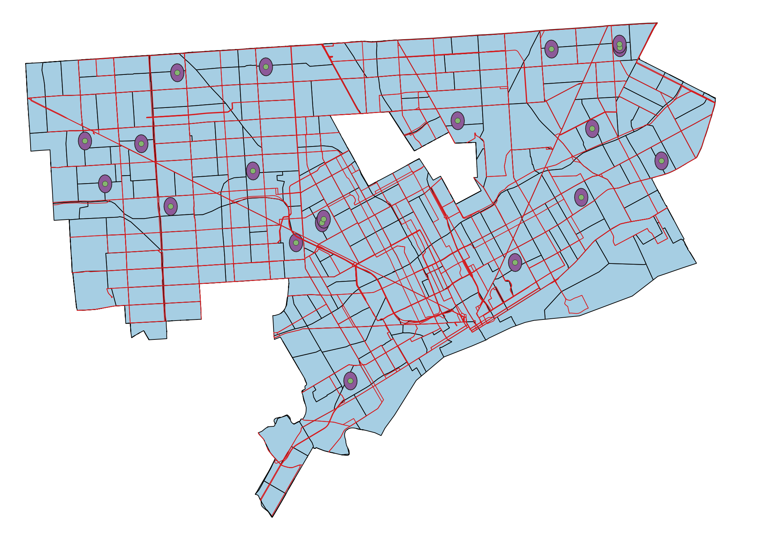
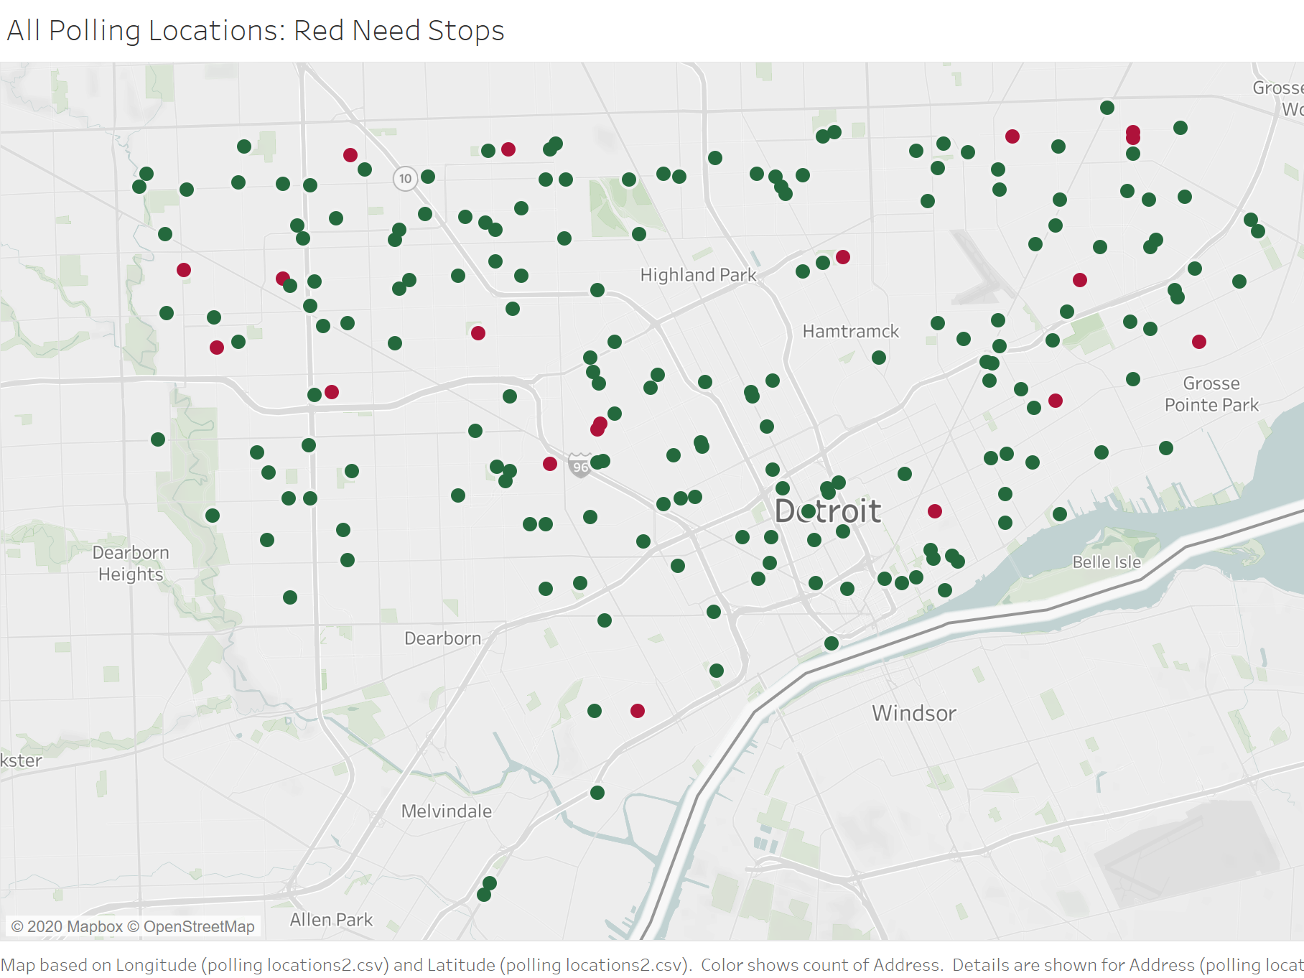
Polling Locations Needing Bus Access
Notes:
Rabia
19 locations out of 201 polling locations
Based on a study of transportation habits, we set a quarter-mile limit on how far we expect someone to walk when using public transportation (Watson 2015). The limitations of our available data required that we convert this distance to .0036 degrees, following a conversion chart (Approximate Metric Equivalents). Using QGIS, we created a quarter-mile buffer around the polling locations. This provides a visualization of the polling locations that will be considered for our analysis (Appendix E). Using this image, we identified 19 locations that are outside the buffer of reasonable walking distance from a bus stop (Appendix F).

Slide 16
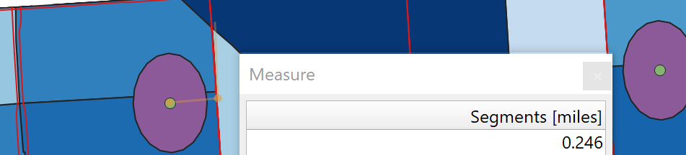
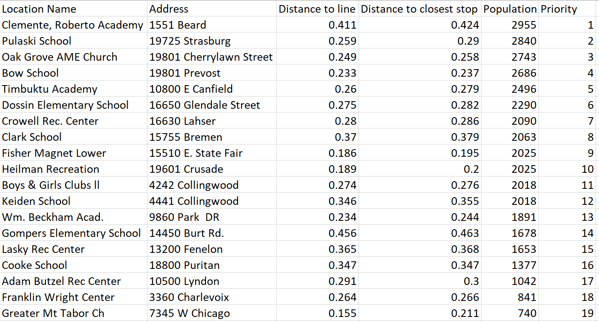
Measuring Distances
Notes:
Rabia
measure using QGIS tool
distance to line range 0.115mi - 0.456mi
distance to stop range 0.195mi -0.463mi

Slide 17
Prioritizing by Population
Notes:
Rabia
Population range 740-2955
2010 Census data
Of those 19, we identified four locations--two pairs--that warrant special attention. Each pair includes two locations that are very close together and that are outside of reasonable walking distance of a bus stop. Although these locations are not in high population areas, we chose to prioritize these locations, since we can use one bus detour to solve the problem at both locations in the pair. The first pair includes Boys and Girls Clubs II and Keiden School, just 500 feet apart, and the second pair includes Heilman Recreation and Fisher Magnet Lower, located on the same block. Based on the close proximity of the locations in these pairs, we conclude that it is reasonable to assume that a detour for one of the polling locations would also benefit voters going to the other polling location. In addition to the four locations included in the pairs, there are 15 other polling locations that require attention.
Building on this list of 19, we included the population in the polling location’s Census tract and the distance from the polling location to the nearest bus stop. In order to create the opportunity for flexibility, we prioritized the 19 stops using both parameters: population (Appendix G) and distance (Appendix H).

Slide 18
Proposed Solutions
Minimize Waiting Time by Adding Buses to Existing Routes on Election Days
20 routes
Rent buses for $37,700
Utilize buses not in use for $16,558
Transportation operating budget $50 million
Prioritize by wait time
Assumptions
DDOT adequately meets regular needs
Temporary, no in-depth study
Cannot purchase additional buses for $250,000 each
Notes:
Assign one additional bus to each of these 20 routes on Election Day
24-passenger minibus, 18 hours in Michigan, $1,885
Could negotiate with partners, Detroit Public Schools Community District
Per-person operating cost, number of buses used, and number of passengers served, $827.90
Transportation operating budget is approximately $50 million
Due to a lack of information on how many buses are dedicated to each route on a weekday, we are unable to quantify the resulting decreased waiting time

Slide 19
Proposed Solutions
Minimize Distance to Travel by Adding a Polling Location Stop on Election Days
17 detours (2 pairs)
Prioritize by population
2 minutes
Current buses
Assumptions
Detour for one polling location in the pair would benefit other
Voters see walking distance as obstacle
Greater population, greater return on investment
Notes:
Boys and Girls Clubs II and Keiden School, just 500 feet apart
Heilman Recreation and Fisher Magnet Lower, located on the same block
Furthest (Gompers Elementary School) and closest (Fisher Magnet Lower), 2-minute car ride

Slide 20
Limitations
This analysis will be relevant only until
New census data is recorded
Bus routes or stops are updated
Polling locations are changed or added
Data needed for further analysis
Survey of voter transportation and travel time
Addresses of registered or eligible voters
Specific polling location throughput
General polling location processing times
Notes:
Camille

Slide 21

Opportunities

Slide 22
Opportunities
Combine two proposed solutions
Focus on home/work to bus stop
Extend peak operating hours
Subsidize bus fare
Organize mass pickup locations at public locations
Universities
Libraries
Grocery stores
Senior housing
Carpool within community
Partner with Uber/Lyft
Alter polling locations

Slide 23
Questions?
Thank you.

